Slide 1
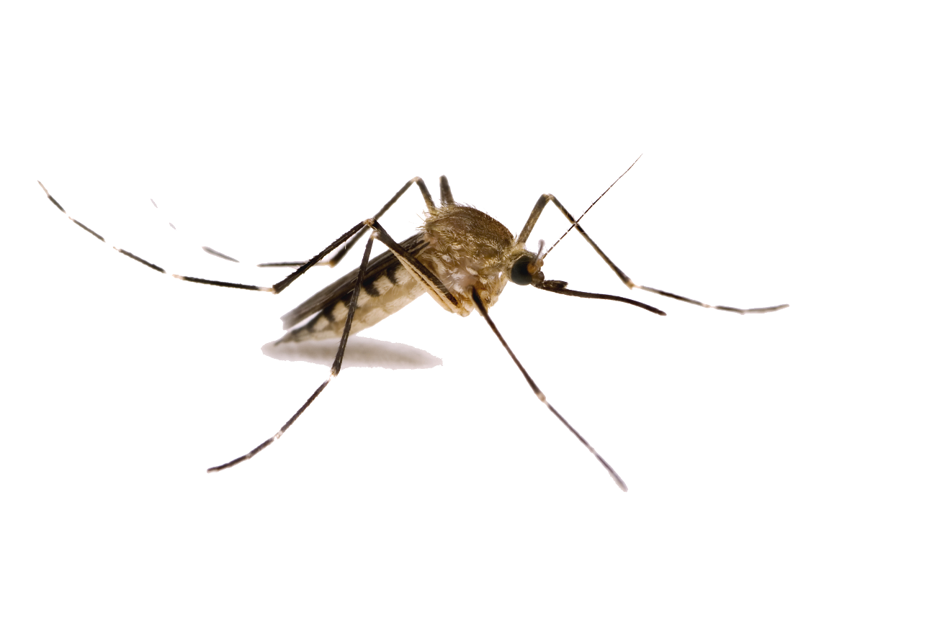

EPIDEMIC OUTBREAK PREDICTION
Team Lead - Joinal Ahmed
Team members
Zahoor Ansari
Soham Shinde

Slide 2
OUTLINE
Introduction
Problem Statement
Objectives
About Zika Virus
Project Architecture
Project life cycle
Technology stack
Airflow
About Dataset
Data Preparation
Exploratory Data Analysis
Feature Selection
Machine Model
Hyperparameter tuning
Deep learning Model
Auto-ML
Model Selection
Model Deployment
Heroku
Docker
Conclusion
Future scope

Slide 3
INTRODUCTION
An epidemic is an occurrence of disease that is temporarily of high prevalence.
The rise and decline in epidemic prevalence of an infectious disease is a probability phenomenon.
Reliable predictions of infectious disease dynamics can be valuable to public health organizations.
Growth of big data in healthcare and biomedical sector.
Availability of huge computational power at hand.

Slide 4

PROBLEM STATEMENT
COVID19 has shown the real face of our healthcare infrastructure, planning, and readiness to address a pandemic with limited resources, unprepared staff, and broken supply chains.
Our idea is to analyze and determine the spread of epidemic diseases in villages and sub-urban areas, where healthcare might not be readily available.
In this project, we aim is to analyze and build a multimodal model to predict the likelihood of an area having an outbreak.

Slide 5
OBJECTIVE
Curbing the preventable disease-related suffering
Minimize financial burden on governments and health care systems.
Given an area,our ML model should be able to find out the possibility of any zika virus cases for next 7 days.
Identify features which contribute significantly in the spread of the outbreak.

Slide 6
ZIKA VIRUS
Zika virus is a mosquito-borne flavivirus that was first identified in Uganda in 1947 in monkeys. It was later identified in humans in 1952 in Uganda and the United Republic of Tanzania.
In March 2015, Brazil reported a large outbreak of rash illness, soon identified as Zika virus infection.
Zika virus is primarily transmitted by the bite of an infected mosquito from the Aedes genus, mainly Aedes aegypti, in tropical and subtropical regions.

Slide 7



Slide 8
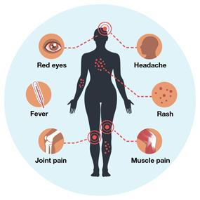
Symptoms typically last for 2–7 days.
The incubation period (the time from exposure to symptoms) of Zika virus disease is estimated to be 3–14 days.
The mosquitoes causing zikavirus are generally active in rainy seasons.
Symptoms

Slide 9
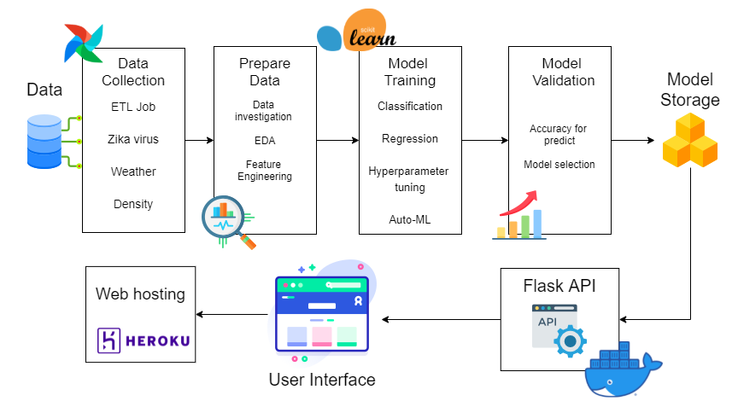
PROJECT ARCHITECTURE

Slide 10
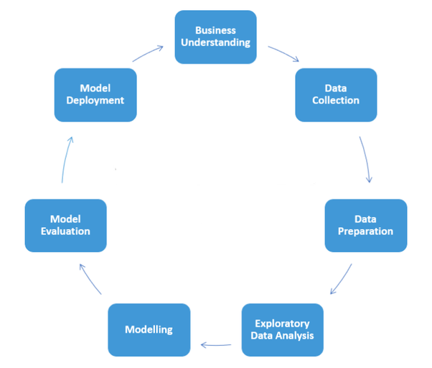
DATA SCIENCE LIFE CYCLE

Slide 11














TECHNOLOGY STACK

Slide 12
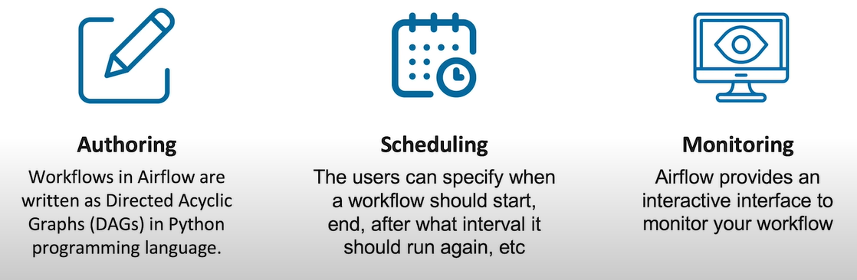
Apache Airflow is an open-source tool to programmatically author, schedule, and monitor workflows.

Slide 13
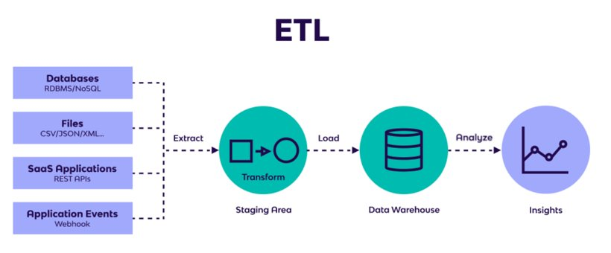

Slide 14
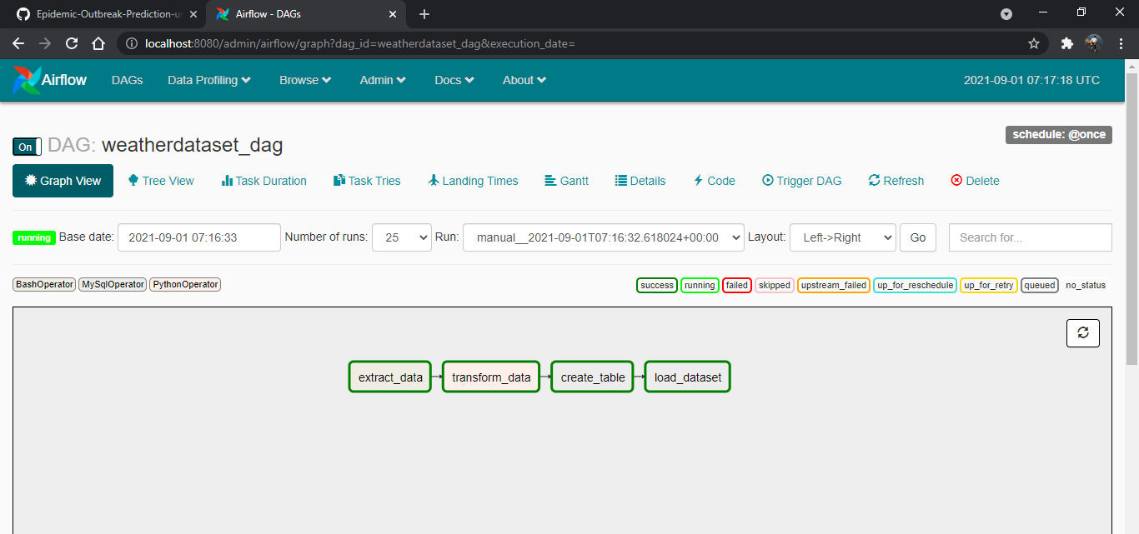
____________ _____________
____ |__( )_________ __/__ /________ __
____ /| |_ /__ ___/_ /_ __ /_ __ \_ | /| / /
___ ___ | / _ / _ __/ _ / / /_/ /_ |/ |/ /
_/_/ |_/_/ /_/ /_/ /_/ \____/____/|__/

Slide 15
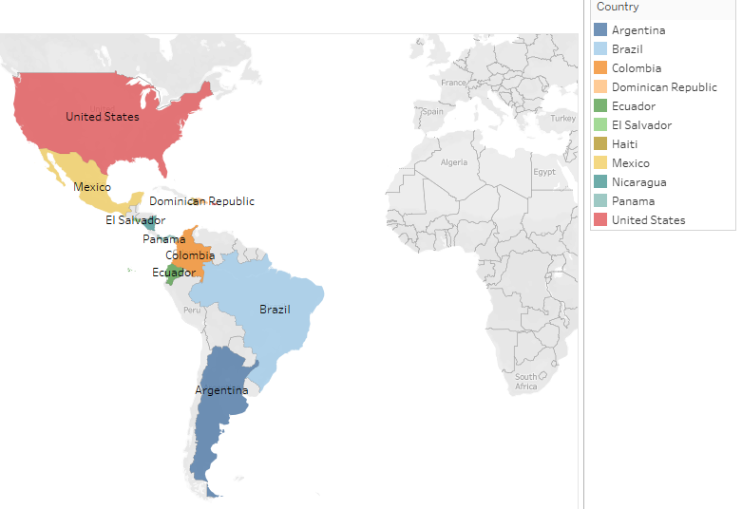
DATASET
Zika virus
Weather
Density population
Latitude longitude

Slide 16
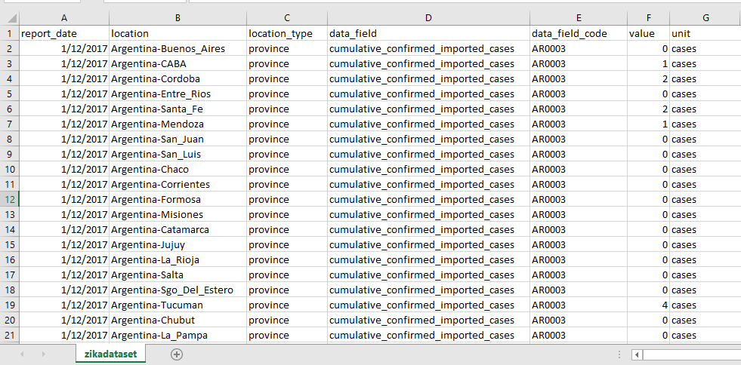
ZIKA VIRUS DATASET
Zika virus repository: https://github.com/cdcepi/zika

Slide 17
WEATHER DATASET
Source: https://www.worldweatheronline.com/developer/api/historical-weather-api.aspx
from wwo_hist import retrieve_hist_data
frequency = 24
api_key = '092a2ffeb04645c5ba855736210909'
start_date = '2016-02-04'
end_date = '2016-03-04'
location_list = ['Argentina']
hist_weather_data = retrieve_hist_data(api_key,
location_list,
start_date,
end_date,
frequency,
location_label = False,
export_csv=True)

Slide 18
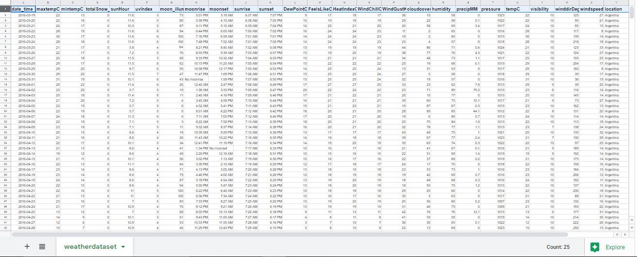
WEATHER DATASET

Slide 19
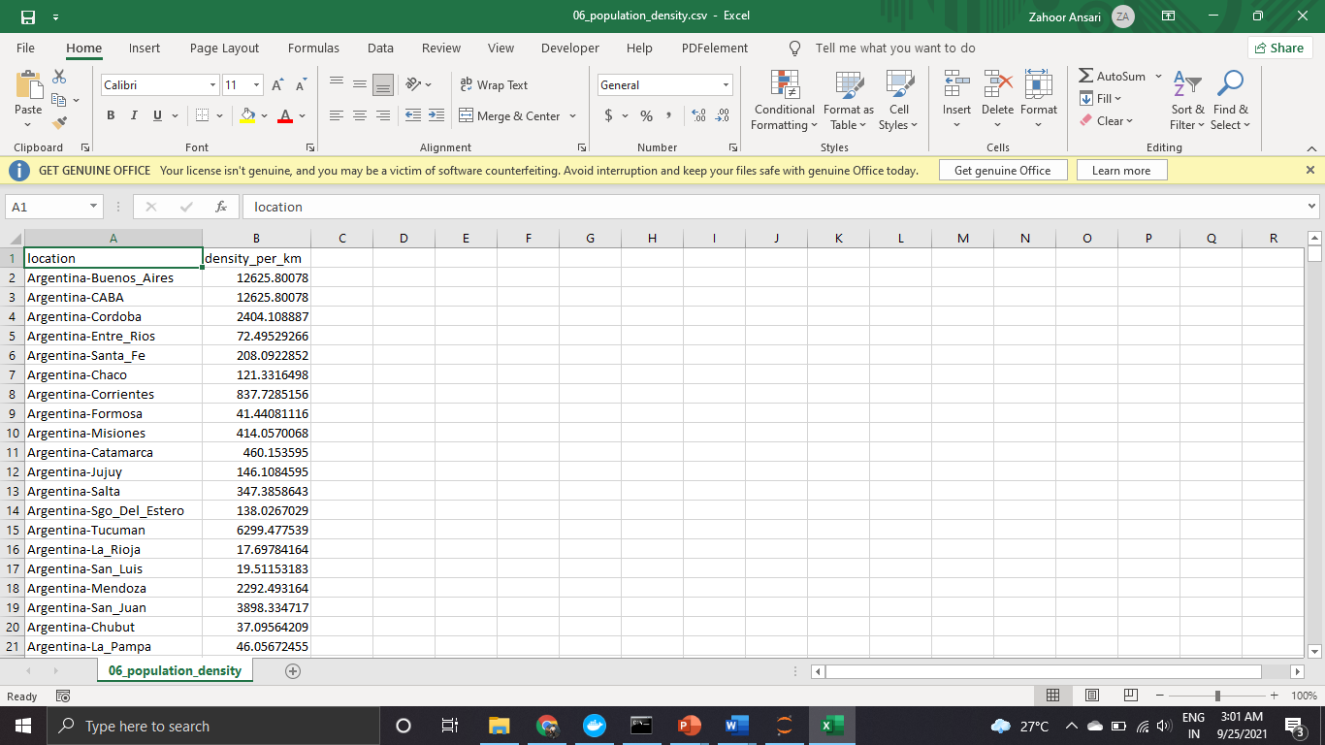
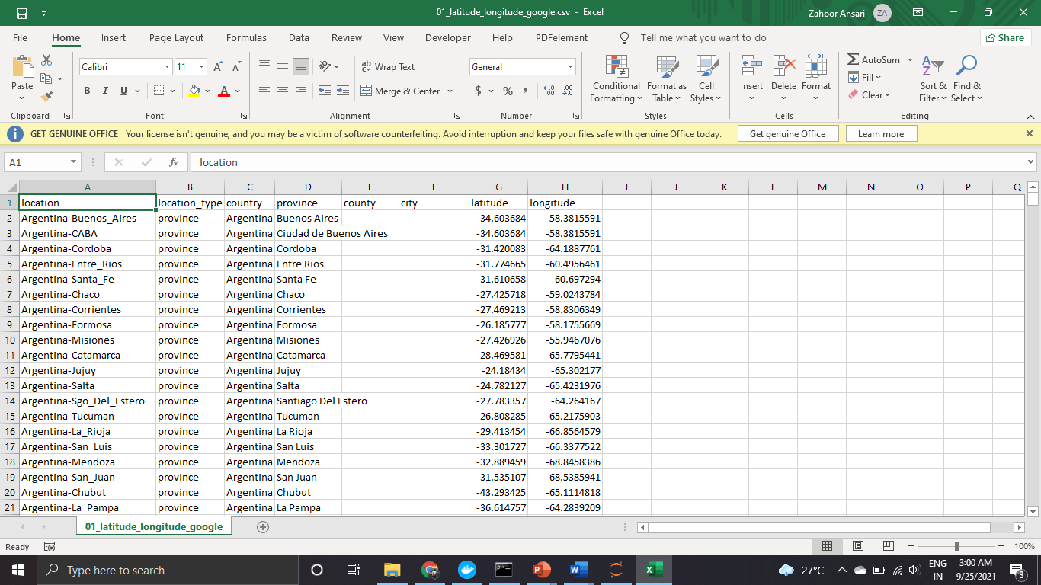
POPULATION DENSITY DATASET
LATITUDE LONGITUDE DATASET

Slide 20
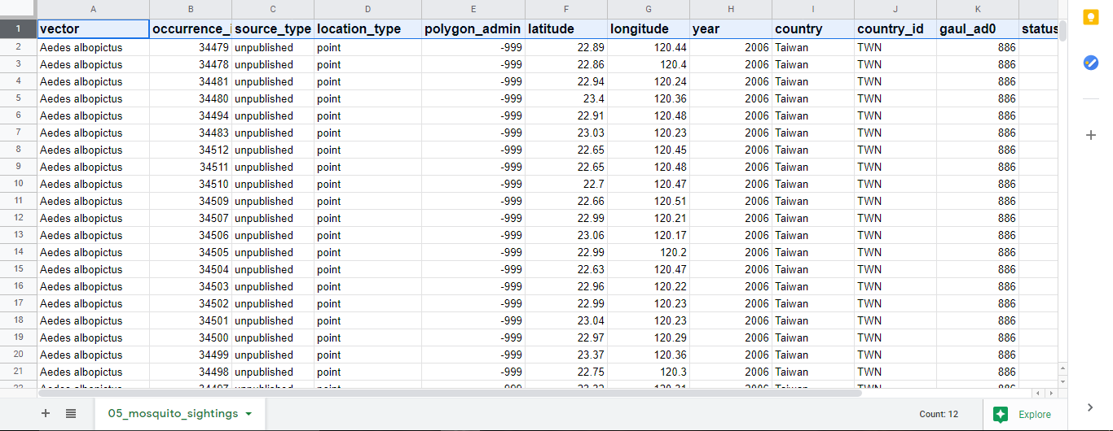
MOSQUITO DATASET
Two kinds of vectors: Aedes Aegypti and Aedes Albopictus

Slide 21

DATA PREPARATION
Zika Virus
Weather
Population density
Latitude Longitude

Slide 22
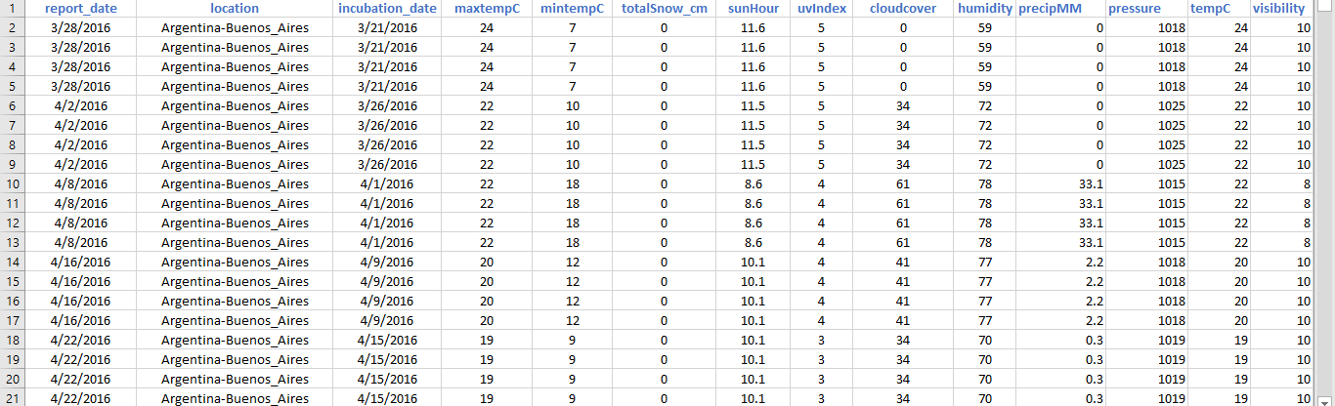
DATA PREPARATION
Data Understanding
Data cleaning

Slide 23
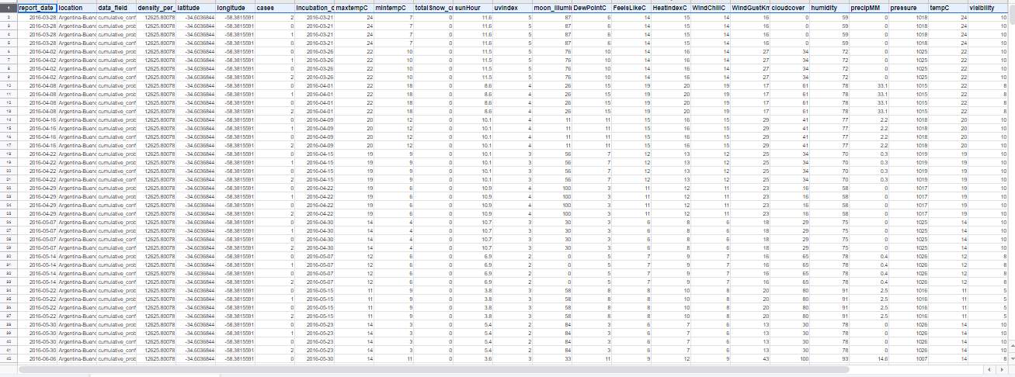
FINAL DATASET
For classification: 75345 rows X 25 columns
For regression: 103045 rows X 25 columns

Slide 24
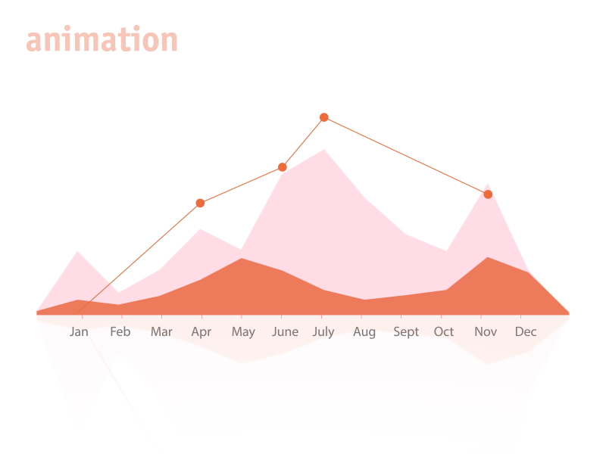
EXPLORATORY DATA ANALYSIS

Slide 25







Weather
Population
Density
Argentina
United States
Brazil
Colombia
Dominican Republic
Ecuador
El Salvador
Guatemala
Haiti
Mexico
Nicaragua
Panama
Puerto Rico
U.S. Virgin Islands.
2016 - 2018

Slide 26
MOSQUITO
Zikavirus is a mosquito-borne disease generally caused by Aedes vector family.
Ae. aegypti is native to Africa while Ae. albopictus also known as asian tiger mosquito originates from Asia; both species now have a worldwide distribution.
Ae. aegypti invaded in Americas back in 1600 during slave trade from Africa while Ae. albopictus was recently found out in Texas in 1985.

Slide 27
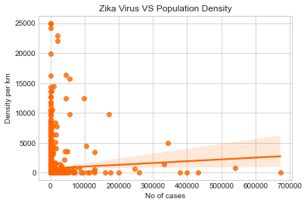
POPULATION DENSITY
Country | No. of cases | Density
Panama Metro Las_Garzas | 9389432 | 1966.26
United States Puerto Rico | 19 | 24970.13

Slide 28
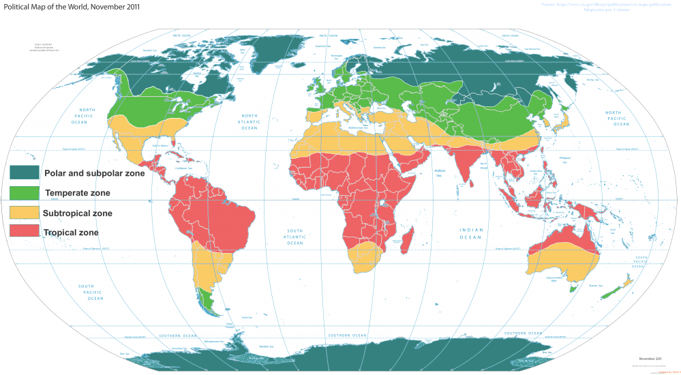
WEATHER
Tropical zone
These are the regions where fixed months of any particular season is observed.
Precipitation only falls during the summer months, usually from may-august with June and July having the heaviest rain
Subtropical zone
These are the regions where there is no fixed period of a particular season.
Summer, the average temperature is between 70 and 80 degrees
Rain falls throughout the year.
There are 9/10 days with rainfall per month from October to April.

Slide 29
Tropical and sub-tropical analysis

Slide 30
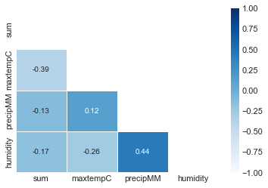
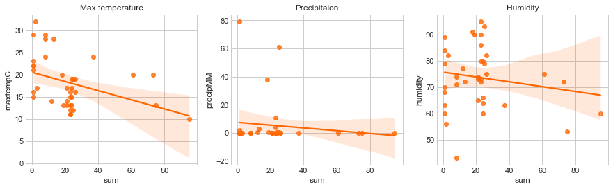
WEATHER SUB-TROPICAL REGION
Argentina

Slide 31
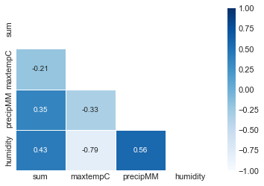
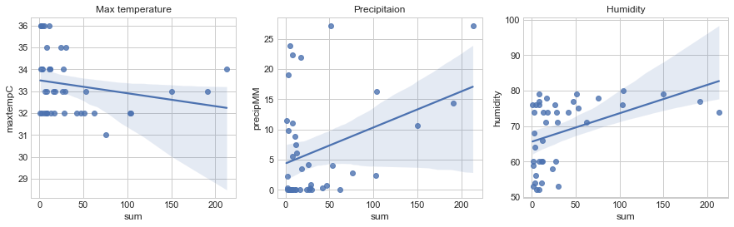
WEATHER TROPICAL REGION
Nicaragua

Slide 32
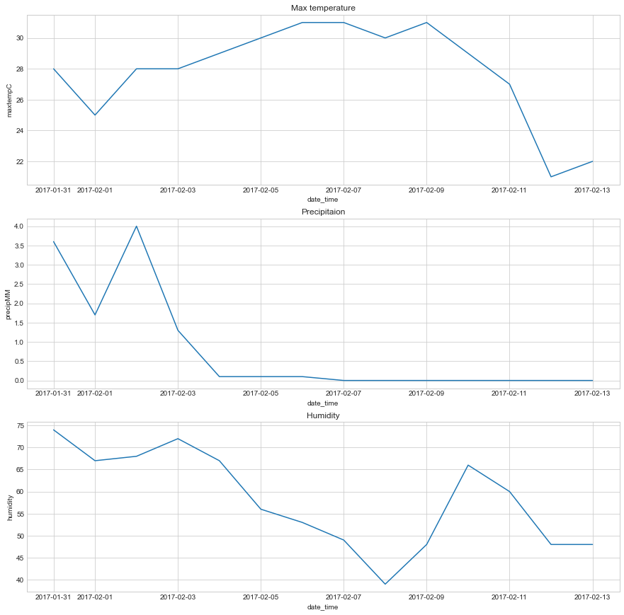
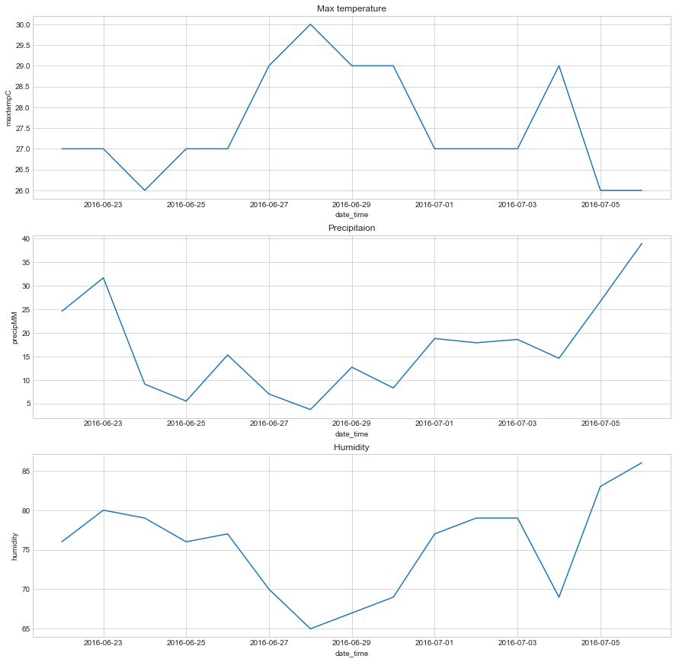
WEATHER With incubation period
United states - Florida
Case 1
Report date - 2016-07-06 = 0
weather date - 2016-06-22 to 2016-07-06
Case 2
Report date - 2017-02-13 = 214
weather date - 2017-01-31 to 2017-02-13

Slide 33
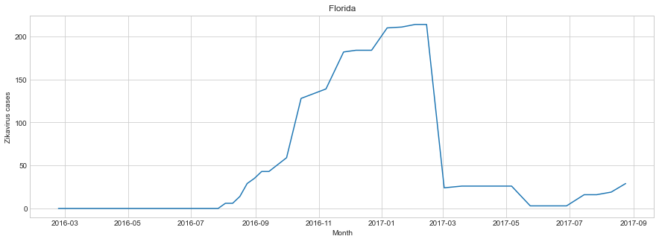
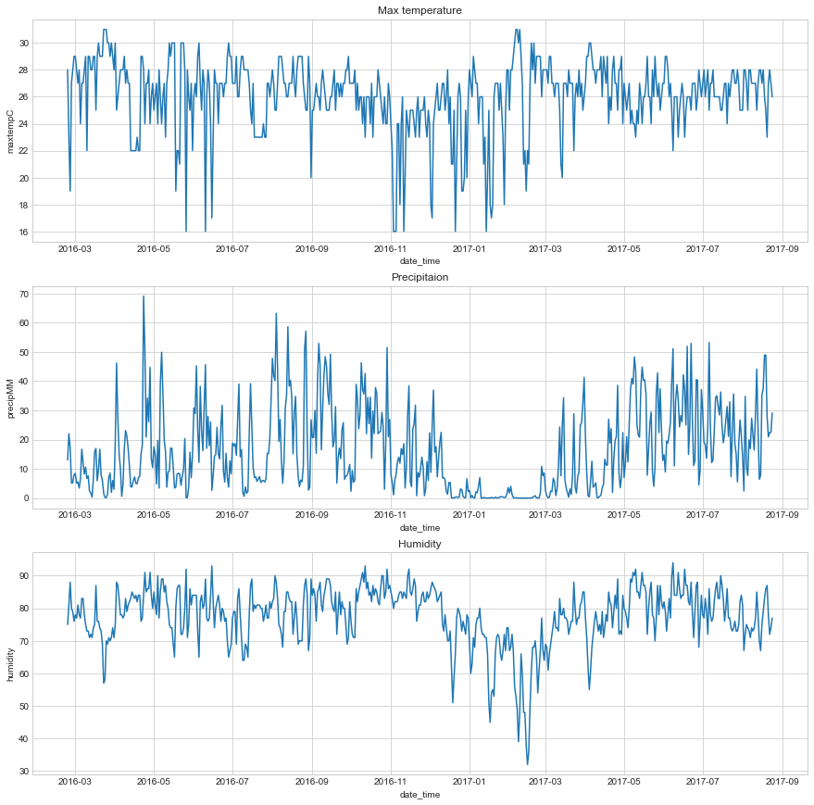

Slide 34
INSIGHTS
Mosquitoes:
Zikavirus is mainly spread due to Aedes family mosquitoes.
Sightings of Ae. aegypti are more than Ae. albopictus in American countries
Ae. aegypti is more prone to cause zikavirus.
Zika Virus Cases vs Population Density:
There is no certain relation between number of cases and population density of a certain area
For some regions, number of cases are high and population density is low while for other regions, number of cases are low and population density is high.
Zika Virus Cases vs Weather:
For subtropical regions, number of cases are affected by sudden changes in weather.
For tropical regions, number of cases are affected by the commencement of monsoon season.
Precipitation and humidity play an important part in the variance of number of Zikavirus cases.

Slide 35
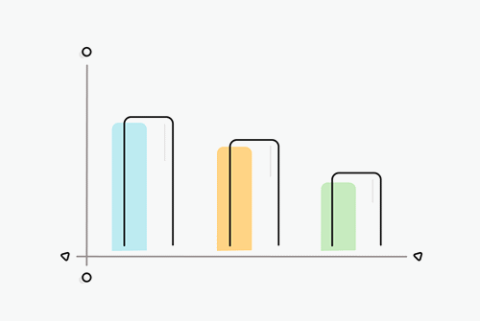
FEATURE SELECTION

Slide 36
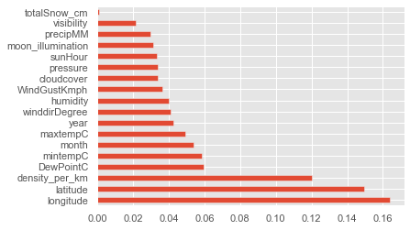
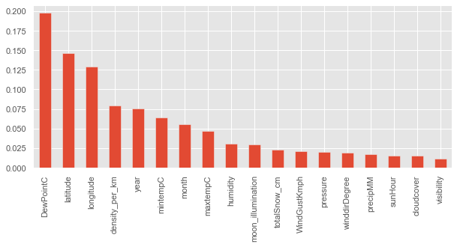
FEATURE SELECTION Based on Extratreesclassifier and XGBoost
Feature scaling method used: MinMax Scaler.
Extra Trees Classifier
XGBoost

Slide 37
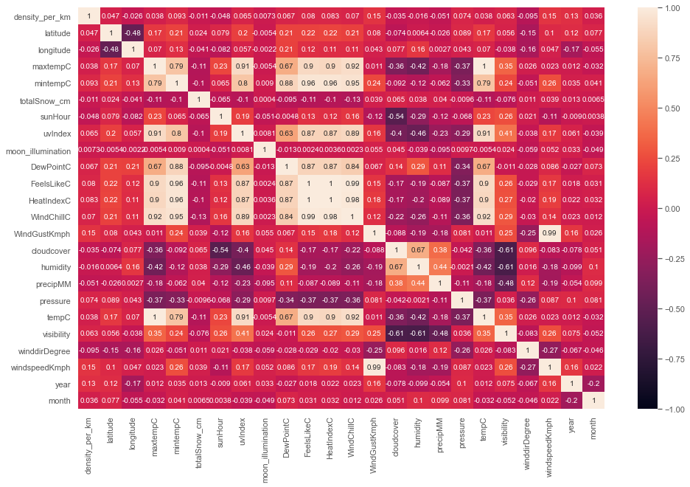
FEATURE SELECTION
Based on Correlation Matrix

Slide 38
Final Features selected for model building
Independent Features:
'density_per_km', 'latitude', 'longitude', 'maxtempC', 'mintempC', 'totalSnow_cm', 'sunHour', 'moon_illumination’,
'DewPointC', 'WindGustKmph', 'cloudcover', 'humidity’, 'precipMM', 'pressure', 'visibility’, 'winddirDegree', 'year', 'month’
Dependent Features : Target (0,1) – Classification
Cases - Regression

Slide 39

MODEL BUILDING
Classification Model
Regression Model

Slide 40
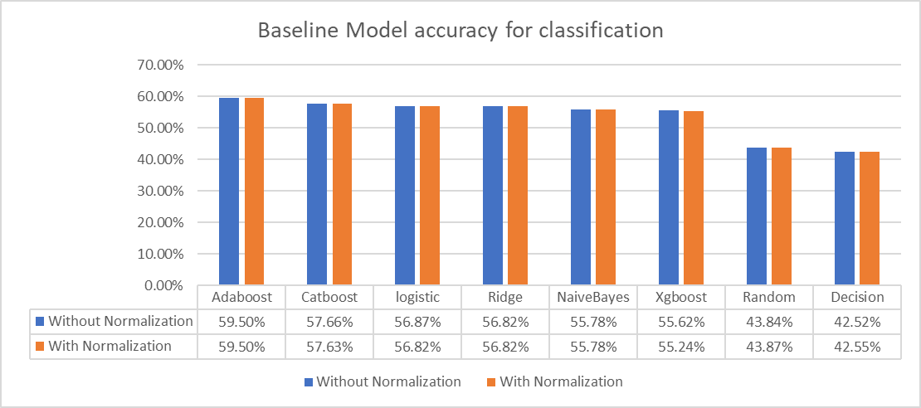
Classification

Slide 41
Baseline models for Regression
Model | Mean Squared Error | Coefficient of Determination (R² value)
Linear Regression | 482209.82 | 0.00673
Lasso | 482521.69 | 0.00624
Ridge | 482442.85 | 0.00673
Decision Tree Regressor | 902975.40 | -0.859
Random Forest Regressor | 669564.42 | -0.37
XGBoost Regressor | 512600.67 | -0.005

Slide 42
HYPERPARAMETER TUNING

Slide 43
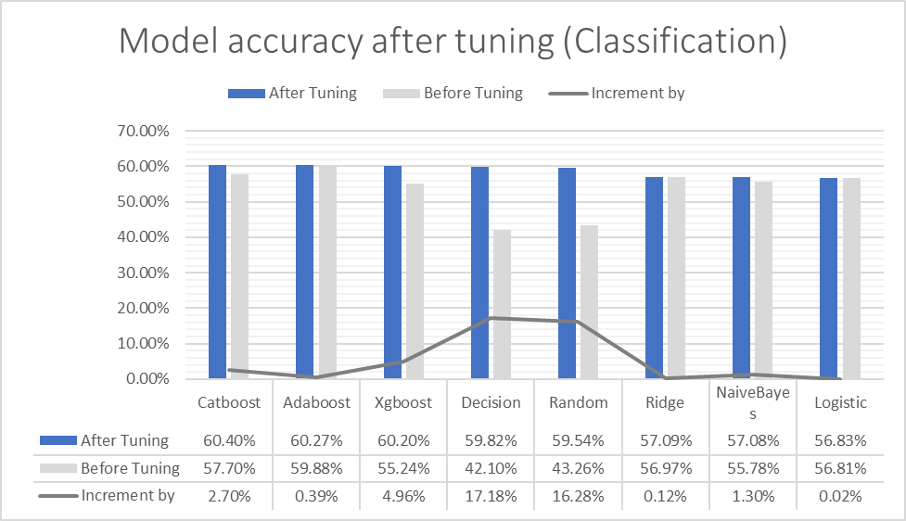
Classification

Slide 44
Model performance after tuning (Regression)
Model | Mean Squared Error | R² value | % increase
Lasso | 546999.53 | 0.0067 | 7.46
Ridge | 514096.20 | 0.0066 | 1.49
Decision Tree Regressor | 481223.73 | 0.0087 | 101.02
Random Forest Regressor | 441754.63 | 0.090 | 124.32

Slide 45
AUTO-ML
Auto-Sklearn
Auto-Gluon
Tpot

Slide 46
Auto-Sklearn
Auto-Sklearn is an open-source library for performing AutoML in Python.
It makes use of the popular Scikit-Learn machine learning library for data transforms and machine learning algorithms.
It uses a Bayesian Optimization search procedure to efficiently discover a top-performing model pipeline for a given dataset.
 | Classification | Regression
Best Model | Gradient Boost | Random Forest
Performance | 60% accuracy | 0.07 R² value

Slide 47
AutoGluon
AutoGluon enables easy-to-use and easy-to-extend AutoML with a focus on automated stack ensembling, deep learning, and real-world applications spanning text, image, and tabular data.
AutoGluon-Tabular currently supports the following algorithms and trains all of them if no time limit is imposed:
Random Forests
Extremely Randomized trees
k-nearest neighbors
LightGBM boosted trees
CatBoost boosted trees
AutoGluon-Tabular deep neural networks
 | Classification | Regression
Best Model | Weighted Ensemble | Light Gradient Boost
Performance | 83% accuracy | -0.27 R² value

Slide 48
Tree-based Pipeline Optimization Tool
TPOT is an open-source library for performing AutoML in Python.
It makes use of the popular Scikit-Learn machine learning library for data transforms and machine learning algorithms.
uses a Genetic Programming stochastic global search procedure to efficiently discover a top-performing model pipeline for a given dataset.
 | Classification
Best Model | Gradient Boost
Performance | 60% accuracy

Slide 49
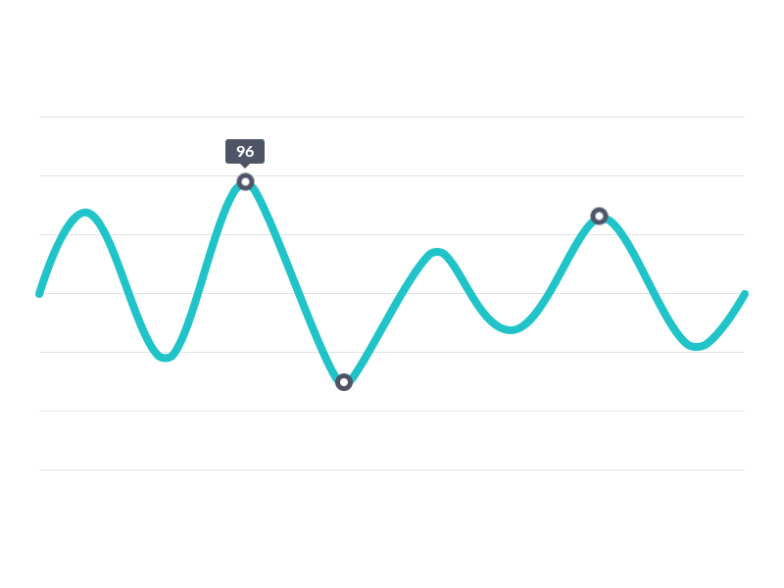
MODEL SELECTION

Slide 50
MODEL SELECTION For Regression
Method: AutoSklearn
Best Model: Random Forest Regressor
Hyperparameter Tuning:
Best Parameters: max_depth=300, max_features='sqrt',
min_samples_leaf=16, min_samples_split=30,
n_estimators=3000, random_state=10
Performance Evaluation:
Mean Squared Error = 441754.63
Coefficient of determination (R2 score) = 0.09

Slide 51
MODEL SELECTION For Classification
Method: Tpot
Best Model: XGBoost Classifier
Hyperparameter Tuning:
Best Parameters: (base_score=0.5, booster='gbtree', colsample_bylevel=1,
colsample_bynode=1, colsample_bytree=1, gamma=0, gpu_id=-1,
importance_type='gain', interaction_constraints='',
learning_rate=0.1, max_delta_step=0, max_depth=2,
min_child_weight=5, missing=nan, monotone_constraints='()',
n_estimators=100, n_jobs=1, num_parallel_tree=1, random_state=10,
reg_alpha=0, reg_lambda=1, scale_pos_weight=1,
subsample=0.9500000000000001, tree_method='exact',
validate_parameters=1, verbosity=0)
Performance Evaluation: Accuracy= 60.373

Slide 52

MODEL DEPLOYMENT

Slide 53
MODEL DEPLOYMENT
In frontend we have created a website with the help of html, CSS and bootstrap framework.
Bootstrap is a powerful toolkit - a collection of HTML, CSS, and JavaScript tools for creating and building web pages and web applications.
In backend: Flask API was used to deploy the machine learning model in backend. It is used to manage HTTP requests and uses API function to get the data and display the result to the end user in front end UI.

Slide 54
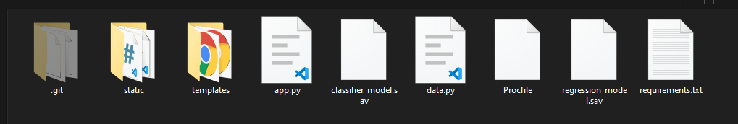
Deployment of a website
Heroku is a container-based cloud Platform as a Service (PaaS). Developers use Heroku to deploy, manage, and scale modern apps.
It is elegant, flexible, and easy to use, offering developers the simplest path to getting their apps to market.

Slide 55

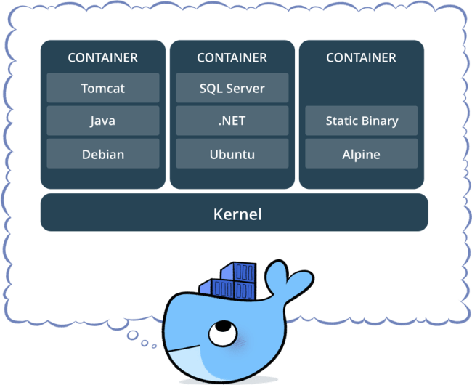




What is the problem statement that docker is trying to solve ?
Docker is an open source platform for building, deploying, and managing containerized applications.

Slide 56
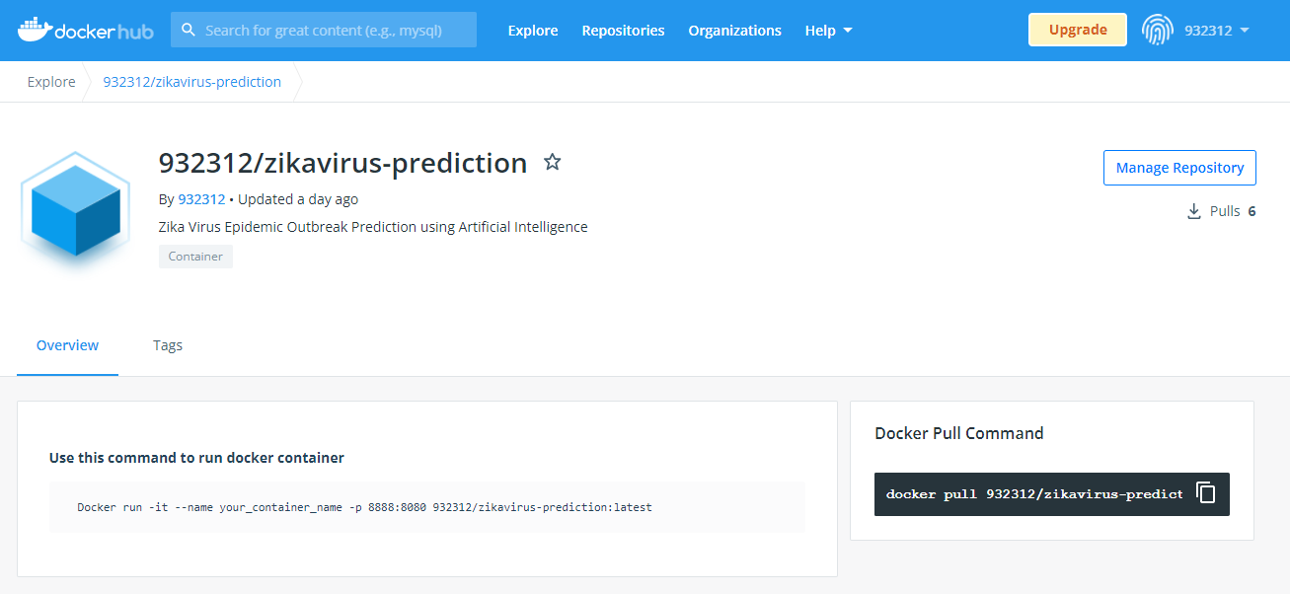

Slide 57
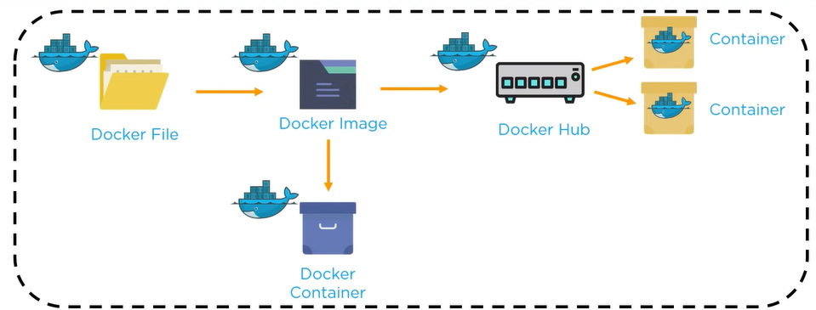
Docker File creates a Docker Image using build command
A Docker Image contains all the project’s code
Using docker image, any user can run the code in order to create docker containers
Once a Docker Image is built, It’s uploaded in a registry or a Docker Hub

Slide 58
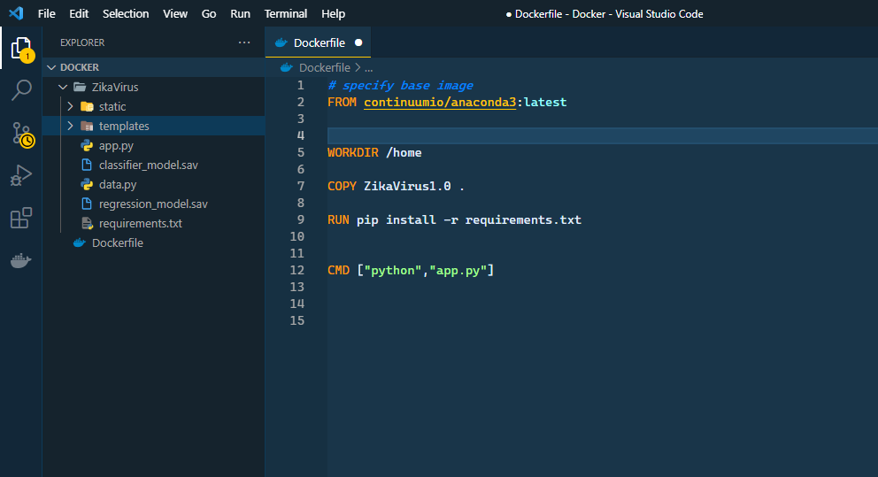

Slide 59
CONCULSION
We were able to load the dataset using Airflow and perform relevant analysis and data manipulation for deriving further insights.
Exploratory Data Analysis was performed in order to obtain visual information on how weather, density was impacting the number of cases.
Post EDA, we implemented dimensionality reduction techniques and did the feature selection.
Various classification and regression algorithms were implemented with hypertuning to understand which model performed well.
AutoML methods such as AutoSklearn, AutoGluon, and TPOT were implemented to check the best model automatically.
UI development using HTML, FLASK API was done in order to create a suitable and interactive UI for prediction and dockerized the whole application.
Dashboard creation for visualizing the insights and zikavirus trend in these countries.

Slide 60
FUTURE SCOPE
We can further extend this project to predict the zika virus cases worldwide.
With availability of weather forecasting data we can predict a possibility of epidemic for more number of days.
Given that our proof of concept worked well, we can augment it further by adding new parameters like social media symptomatic data, life style, population dynamics, etc.
We can study and predict various other epidemics as well using the same approach.
We can additionally request government and healthcare institutions for more data that’s not currently available in the public domain.
A crucial but often ignored factor in ML models is lack of sufficient structured data.

Slide 61
THANK YOU

